Slide 1
Lesson 5
Bug Finding

Slide 2
Lesson 5 Bug Finding
A
Take 2 laptops back to your seat for you and your partner
Log into WeScheme
blockcfda@afsenyc.org
afsestudent
B
Take a 2 Bug Finding Work Sheets
Log into WeScheme
blockcfda@afsenyc.org
afsestudent

Slide 3
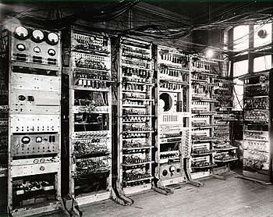
computers were once larger arrays of relay tubes--similar to light bulbs

Slide 4
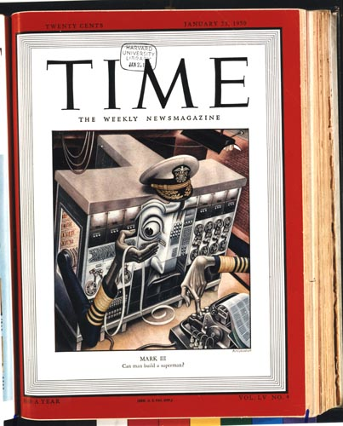
January, 1950
20¢
can man build a superman?

Slide 5
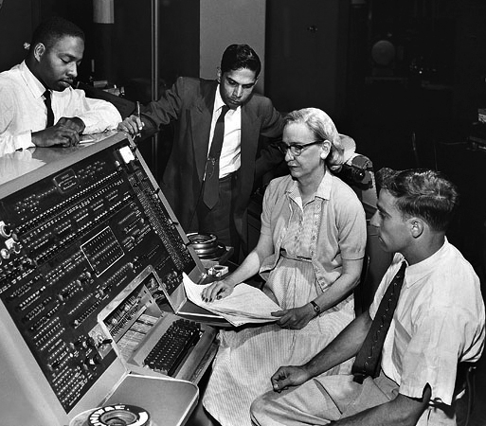
What is a bug?
Admiral Grace Hopper was one of the foremost computer scientists of her day

Slide 6
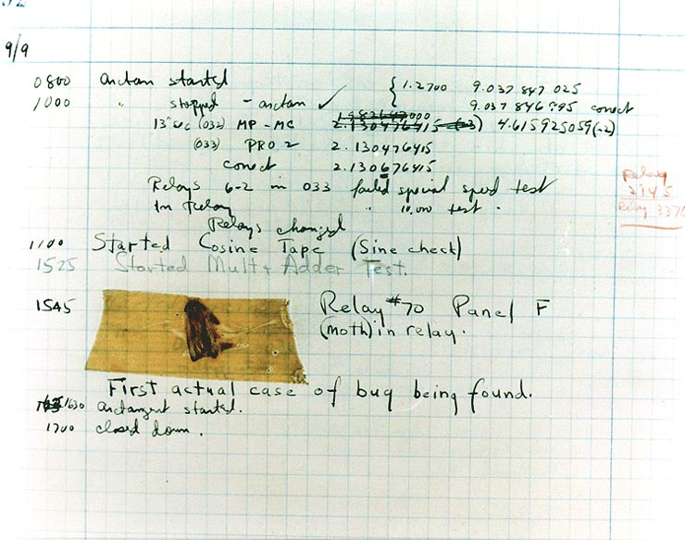
First actual case of bug being found.

Slide 7
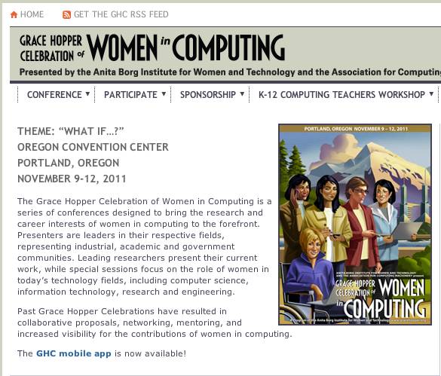
Grace Hopper Celebration of Women in Computing
Computer-scientists gather every year to honor Grace Hopper

Slide 8
Bug Finding
Directions
Open your bug program.
Click run.
Read the error message.
Fix the bug.
Click run again.
Repeat until you have found all of the bugs and the program runs without errors.
Write a sentence explaining each bug on the space provided.

Slide 9
Lesson 5 update-danger
A
Take 2 laptops back to your seat
Log into WeScheme USING YOUR OWN EMAIL ACCOUNT
B
Take 2 update-danger worksheets
Log into WeScheme USING YOUR OWN EMAIL ACCOUNT

Slide 10
Homework due Monday, November 25
Lesson 5 Homework

Slide 11
(0,480)
(640,480)
D
(500,300)
480
P
T
(200,240)
(550,140)
(0,0)
640
(640,0)
Notes:
What are the coordinates of the corners?
Coordinates appear clockwise from origin on click
What is the Danger's x-coordinate? Its y-coordinate?
If it is moving to the left, what is changing: the x or y coordinate? Collect data: one finger for x, two for y.
Suppose it moved to the right by 50 pixels. What are the new coordinates? (550,300)
I want my danger to always move left by 50 pixels, each time the screen is redrawn, so that it goes from (550, 300) to (500,300) to (450, 300), etc.
What if it starts at (100, 100)? Where will go next? What if it’s at (400, 600)? What if it’s off the screen, at (650, 50)? (Answer: (50, 100), (350, 600), (600,50))

Slide 12
What is the domain of update-danger?
Number
String Number
String
Image
Number Number
Notes:
Make wrong options fade out over time, then move on. At fade out add self-reflection questions not overtly addressed in the lecture.

Slide 13
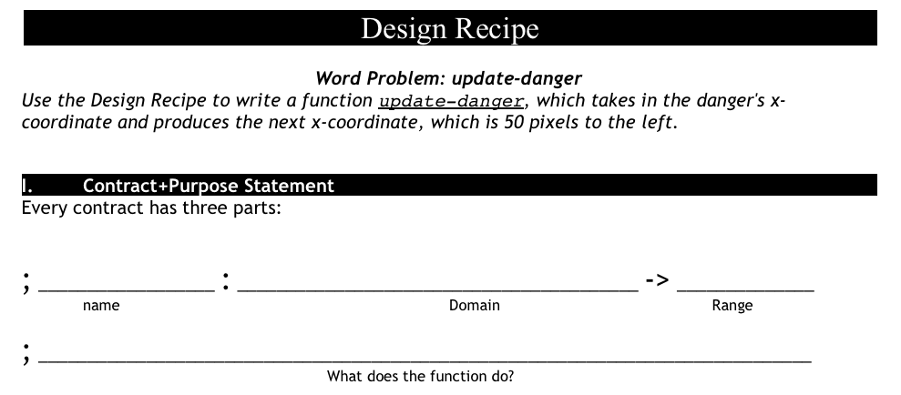
update-danger
what is the name of the function?
what are the inputs?
what are the outputs?

Slide 14
how to write examples for update-danger
Current x-coordinate | Racket Code | Next x-coordinate
50
75
30
(- 50 50)
0
(- 75 50)
25
(- 30 50)
-20
Notes:
Animation : Racket Code -> Next x-coordinate

Slide 15
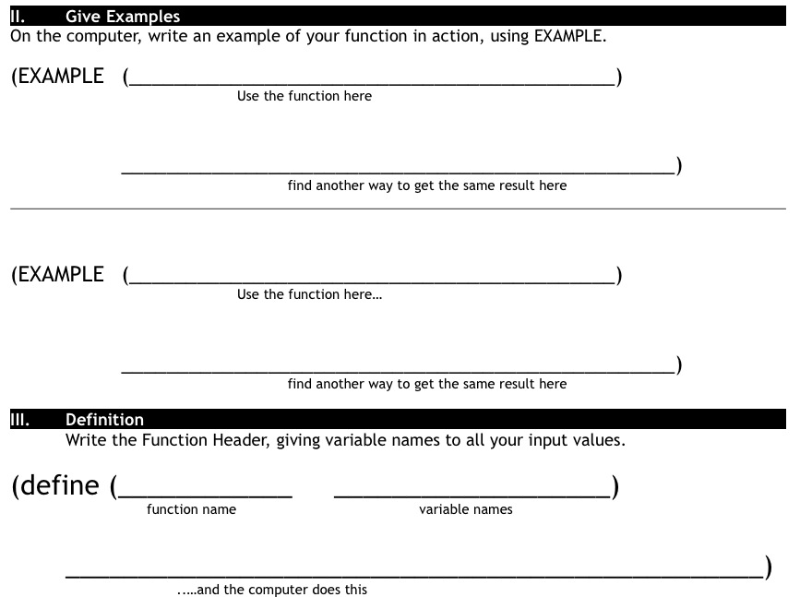
Finish the design recipe with two examples and a definition
Don't forget to circle your examples!

Slide 16
Complete the Design Recipe for update-target
paper first then type
circle examples
ask questions
use your time well

Slide 17
Now you have a 90, don't just satisfy the requirements. Impress me.
Here are some suggestions:
Can you make your danger move slower? faster?
Can you make your target the move other way?
(just try, you can do it)
The promotion goes to the person who goes above and beyond.

Slide 18
Lesson 5 Day 2 - Game Animation
A
Take 2 laptops back to your seat
go to
afsenyc.org/fda
B
Wait for your laptop
go to
afsenyc.org/fda

Slide 19
Restructure of Functions Class
class account is closed down
students will use their own AFSE email account
games will be finished individually, we will no longer work with a partner

Slide 20
Homework due Wednesday 11/28
find new players, dangers, targets, and backgrounds for your game
if you have any trouble with this assignment, see me before the end of the day

Slide 21
start a new game file
sign into your AFSE email
sign into wescheme.org with your AFSE email
copy and paste the code from the email into a new program in WeScheme
save your new game file with a new file name

Slide 22
find your player
search images.google.com for animated gif images
find an image not blocked by the DOE
click the image, then click full-size image
copy and paste the URL of the image into your game file

Slide 23
getting your game just right
what is the contract for bitmap/url?
how do we scale an image?
can you do anything else to your images?

Slide 24
scale your player
; scale: number image -> image
; scale/xy: number number image -> image
how can you use the scale function to scale your player

Slide 25
take out update-danger/update-target worksheet
fix the code for update-danger and update-target in your new game file

